Slide 1
Secure Data Hiding in Image Using Steganography
CAPSTONE PROJECT
Presented By: Avadh Virendra Pandey
Student Name : Avadh Virendra Pandey
College Name & Department : A.P.Shah institute of technology (CS BRANCH) (2024 Passout)

Slide 2
OUTLINE
Problem Statement
Technology used
Wow factor
End users
Result
Conclusion
Git-hub Link
Future scope

Slide 3
Problem Statement
Secure ways to share sensitive data are becoming more and more necessary in today's society, when data privacy is crucial. Traditional encryption methods can attract unwelcome attention, notwithstanding their effectiveness. An alternative is provided by steganography, which hides secret messages behind common images to lessen their visibility.

Slide 4
Technology used
The application is built using core web technologies:
HTML: Structures the web pages.
CSS: Styles the application for an intuitive user experience.
JavaScript: Implements the core functionality for encoding and decoding messages within images.
Netlify: For hosting purpose i have used netlify.
Vscode: is a free, open-source code editor developed by Microsoft.

Slide 5
Wow factors
The main selling point of "cloakit" is how seamlessly steganography is integrated into an intuitive online interface. Messages can be easily hidden and recovered by users without the need for complex technological knowledge or specialist tools. A wider audience may now more easily understand steganography thanks to this method.

Slide 6
End users
For people who value privacy and want to interact discreetly, this app is perfect. Among the possible users are:
1) Journalists: Disseminating private information without drawing notice.
2) Activists: Speaking up in settings when surveillance is common.
3) Users in general: Anyone who wants to make their communications more secure.

Slide 7
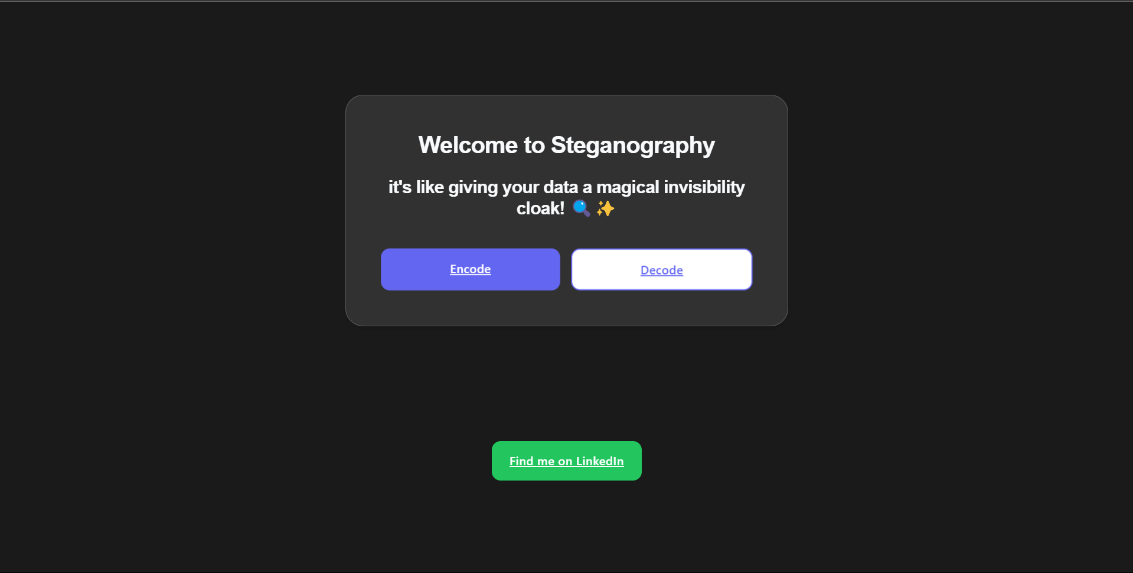
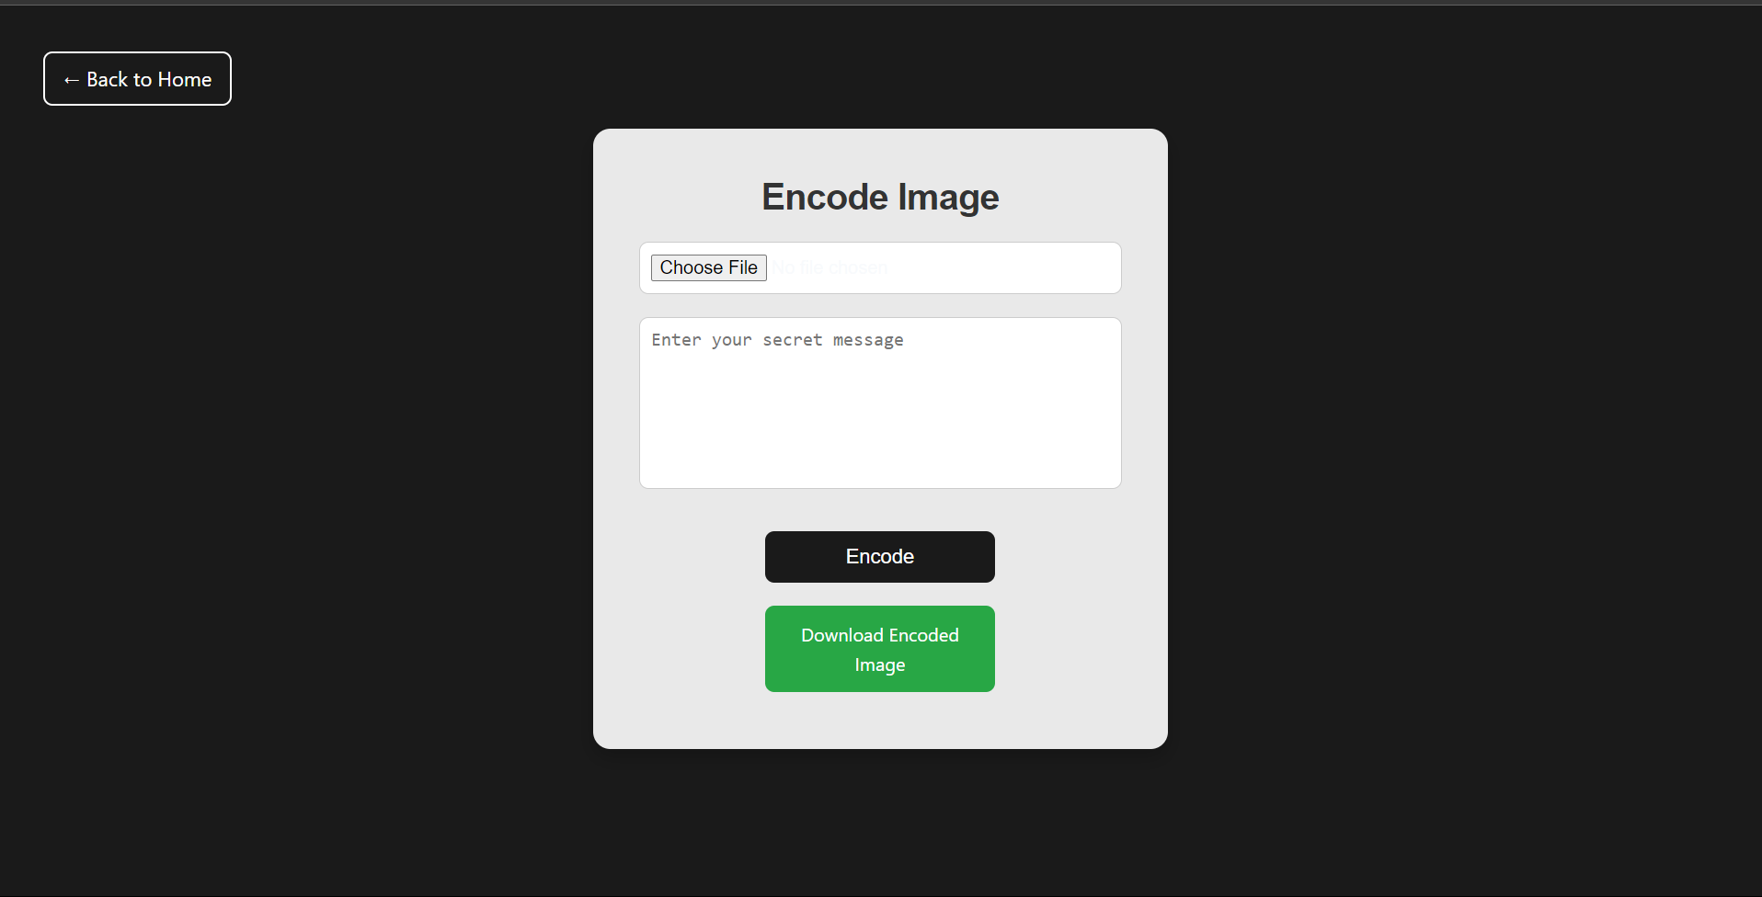
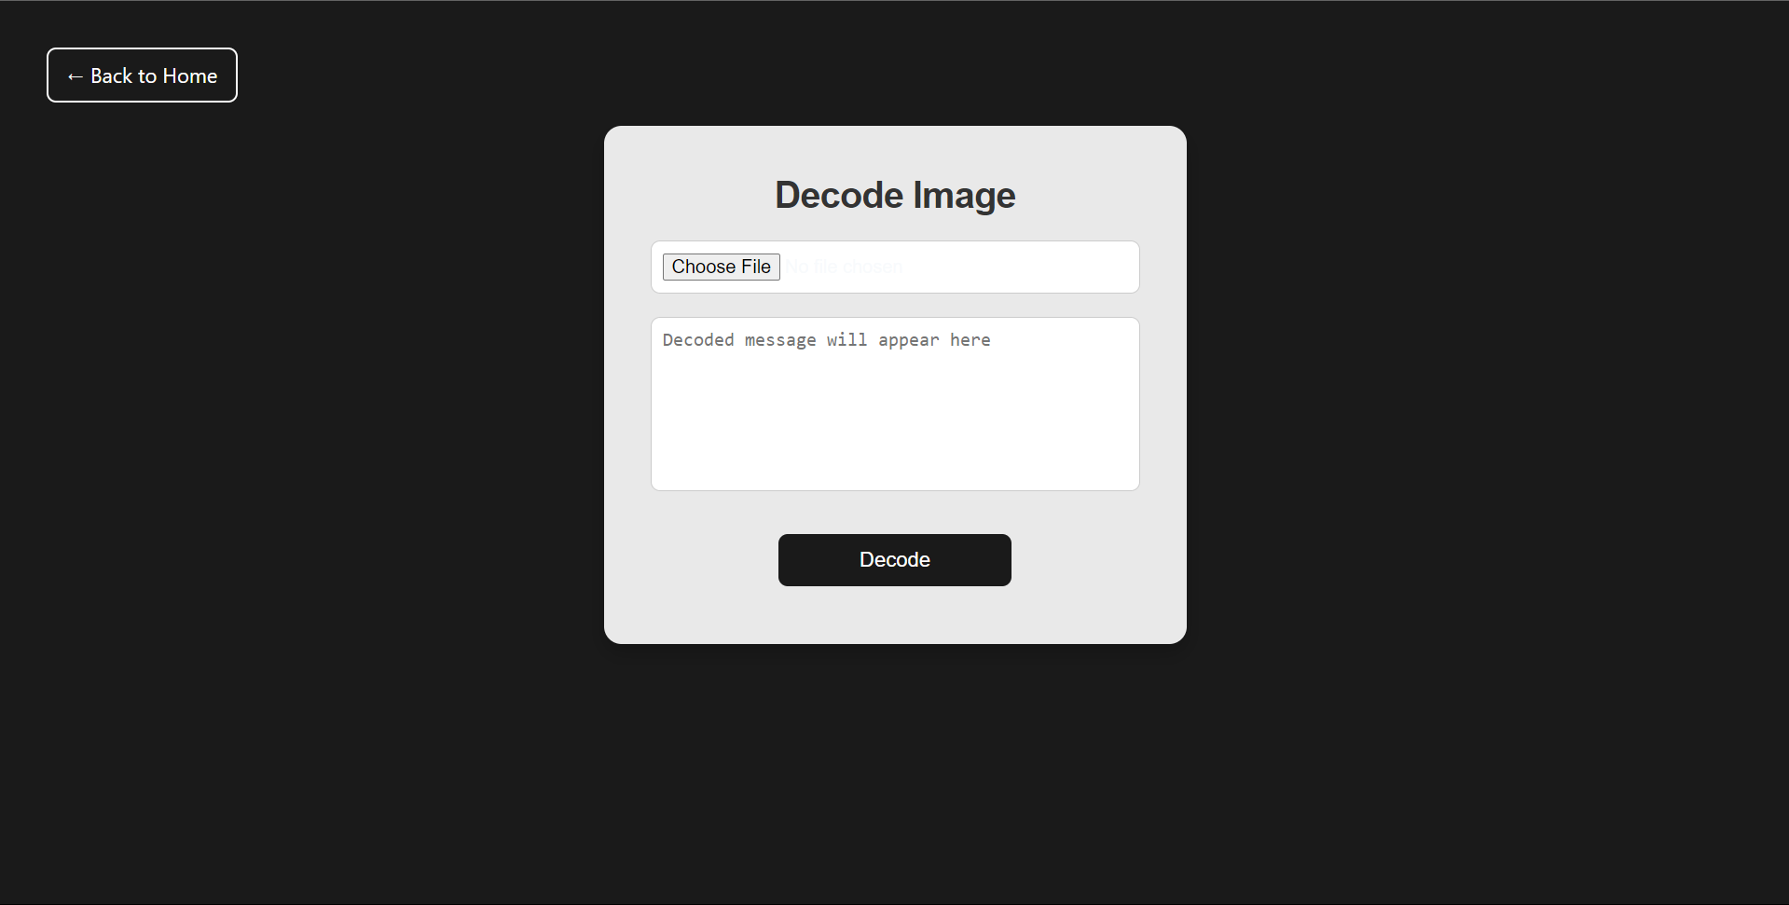
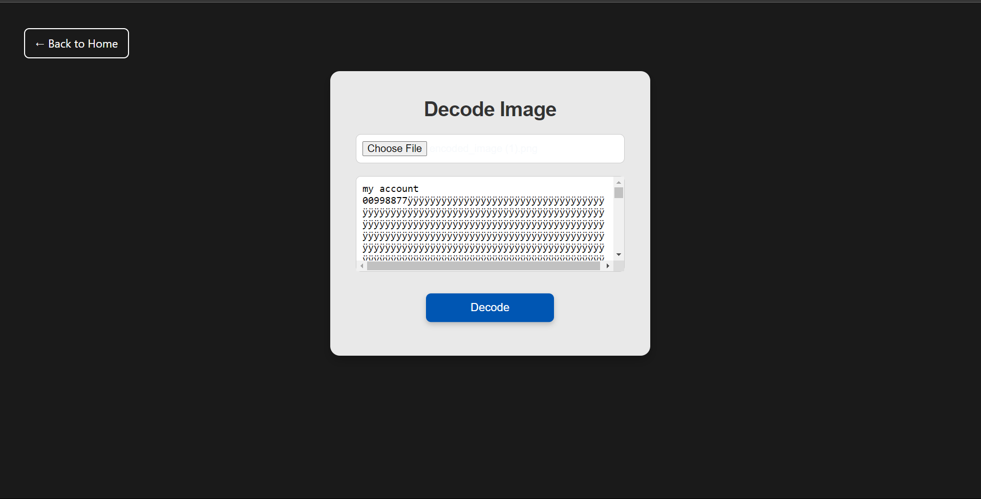
Results

Slide 8
Conclusion
"Cloakit" is a prime example of how traditional steganographic methods can be modified for use in contemporary online applications to improve privacy. It enables users to safeguard their communications without depending entirely on conventional encryption techniques by offering an easily navigable platform.

Slide 9
GitHub Link
https://github.com/avadhPa/cloakit.git
Also hosted on netlify ( https://cloakit.netlify.app/ )

Slide 10
Future scope(optional)
A number of advancements should be taken into consideration to improve "cloakit," including:
Advanced Encryption: Adding an additional degree of protection by encrypting the message using encryption techniques prior to embedding.
Support for Multiple File kinds: Adding more media kinds, such audio or video files, to the functionality for message embedding.
Creating a mobile-friendly version or specialized app in order to reach a larger user base is known as mobile optimization.
Improved User Interface: Making the process even more intuitive by making it better in terms of both design and usability.

Slide 11
THANK YOU

